Slide 1
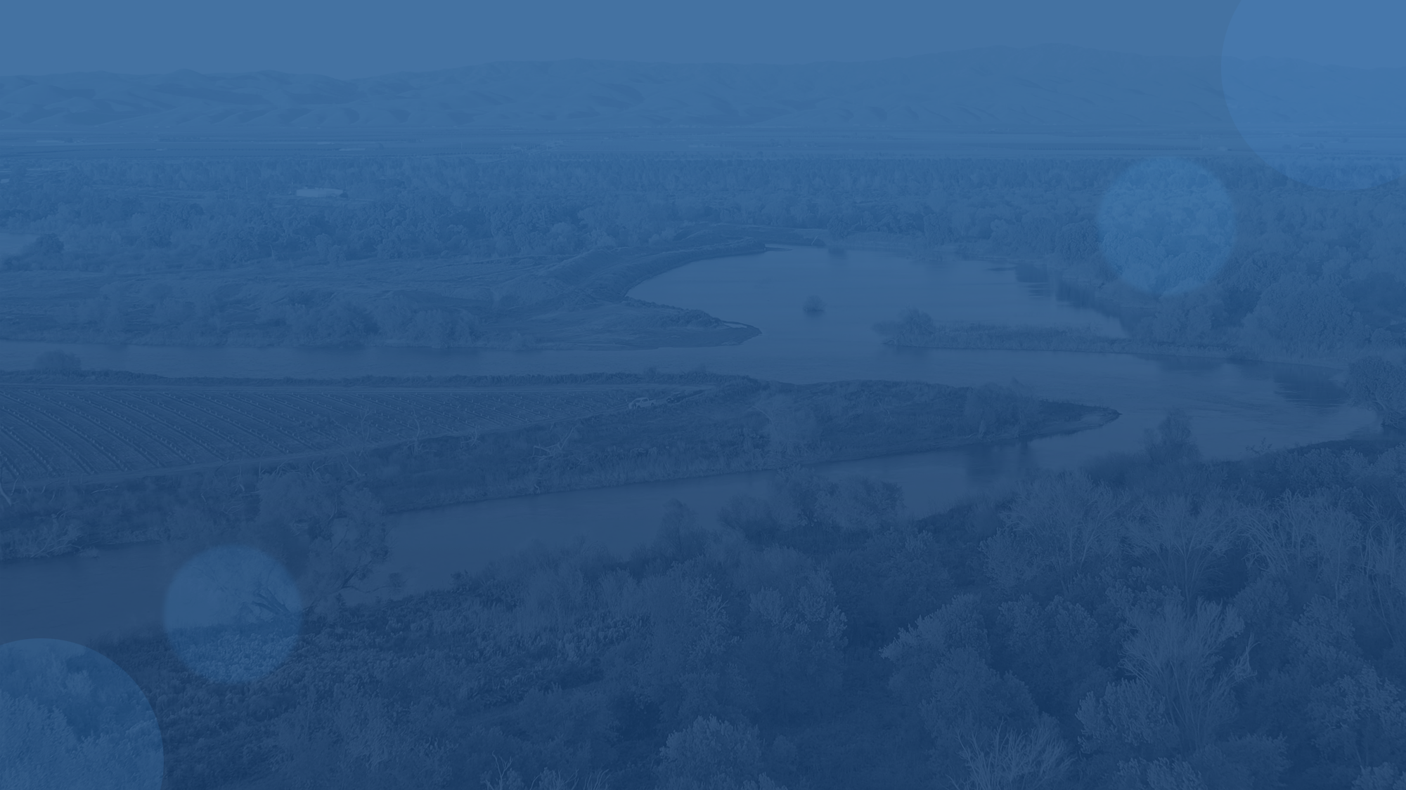
(TITLE) Our Rivers, Our Future.
(Name), (Position) Julie Rentner, President

Slide 2
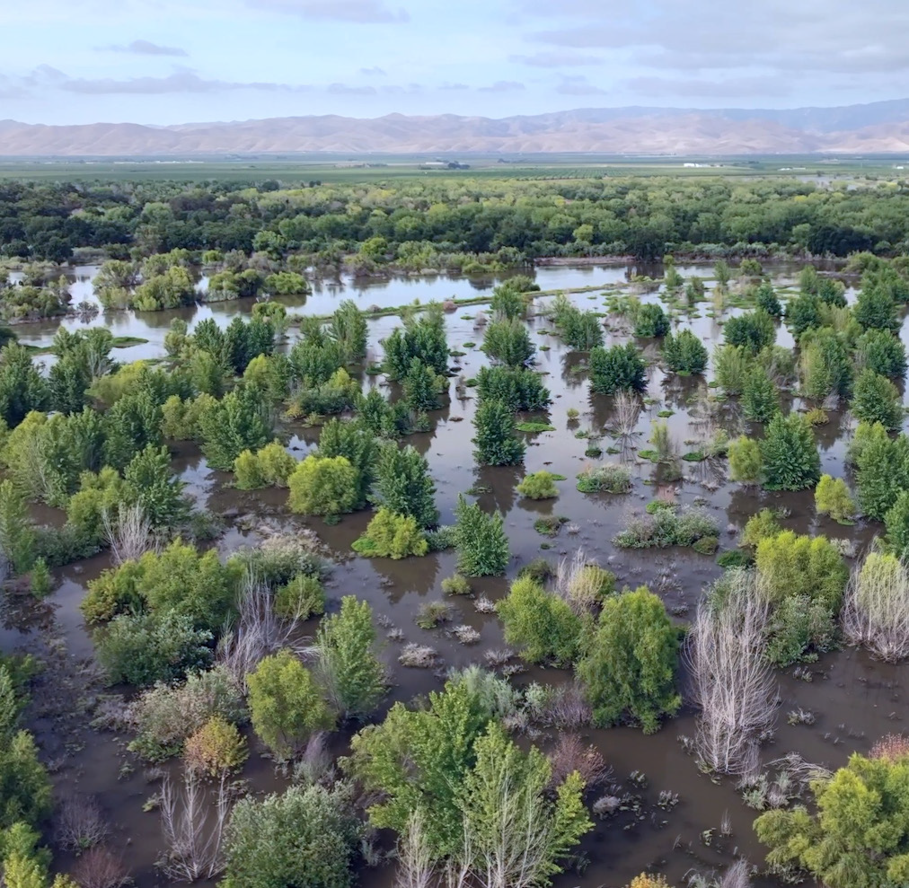
We give rivers new life
Only 5% of California’s riverside habitat is left
Restored riverways are a leading natural solution to climate change, biodiversity loss, droughts, floods, and public-health challenges
We restore native ecosystems along California’s most imperiled rivers
Every year, we plant hundreds of native trees and vegetation across thousands of acres statewide using modern farming practices and innovative science
Notes:
Founded in 1998, River Partners is nonprofit organization that brings life back to California’s rivers to benefit
the environment and people.
We plant hundreds of thousands of native trees and plants across thousands of acres statewide each year.
We’ve restored nearly 20,000 riverside acres since 1998—more than anyone in the West.
Only 5% of the state's riverside habitat is left – and healthy rivers are essential for a thriving state.
We achieve this bold pace and scale by blending an entrepreneurial sprit, modern farming practices, cutting-
edge science, and diverse alliances.
Our work results in major wins for wildlife, flood safety, climate, resilience, water conservation, healthy
communities, and local economies.

Slide 3
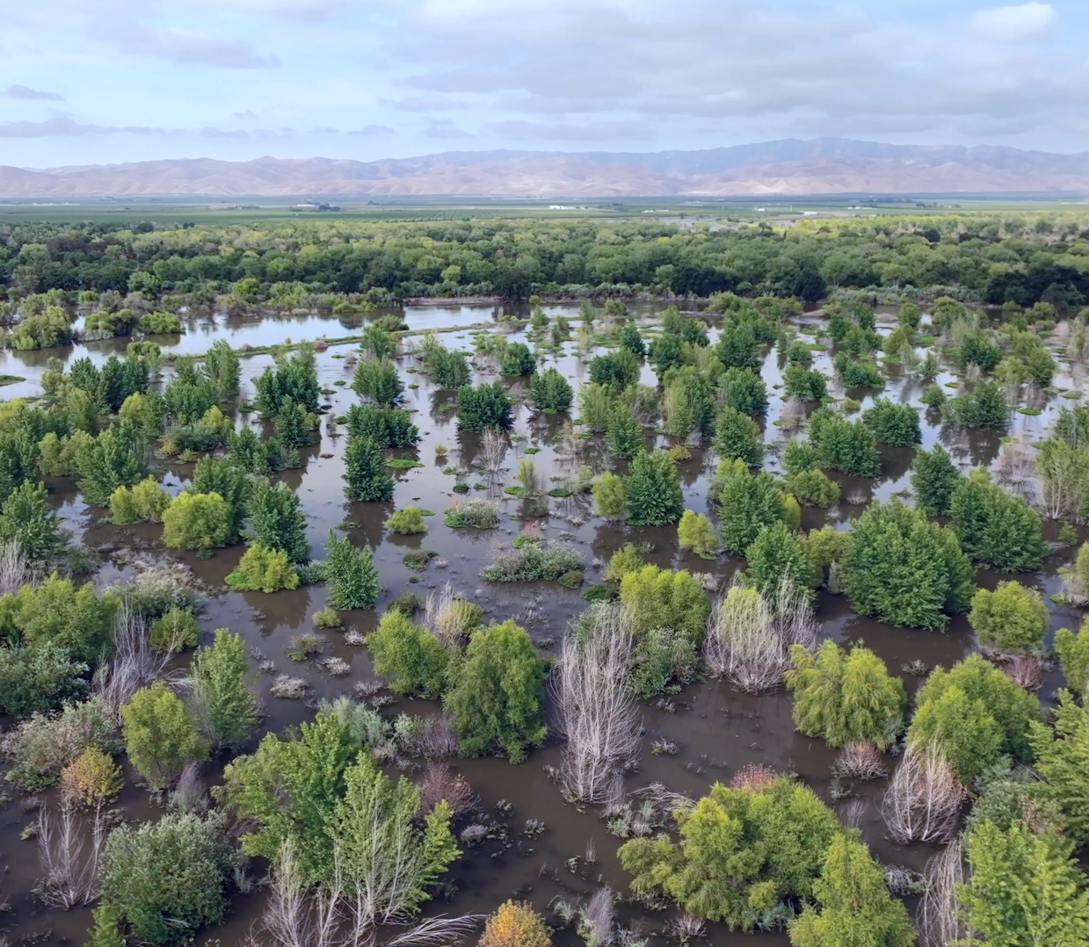
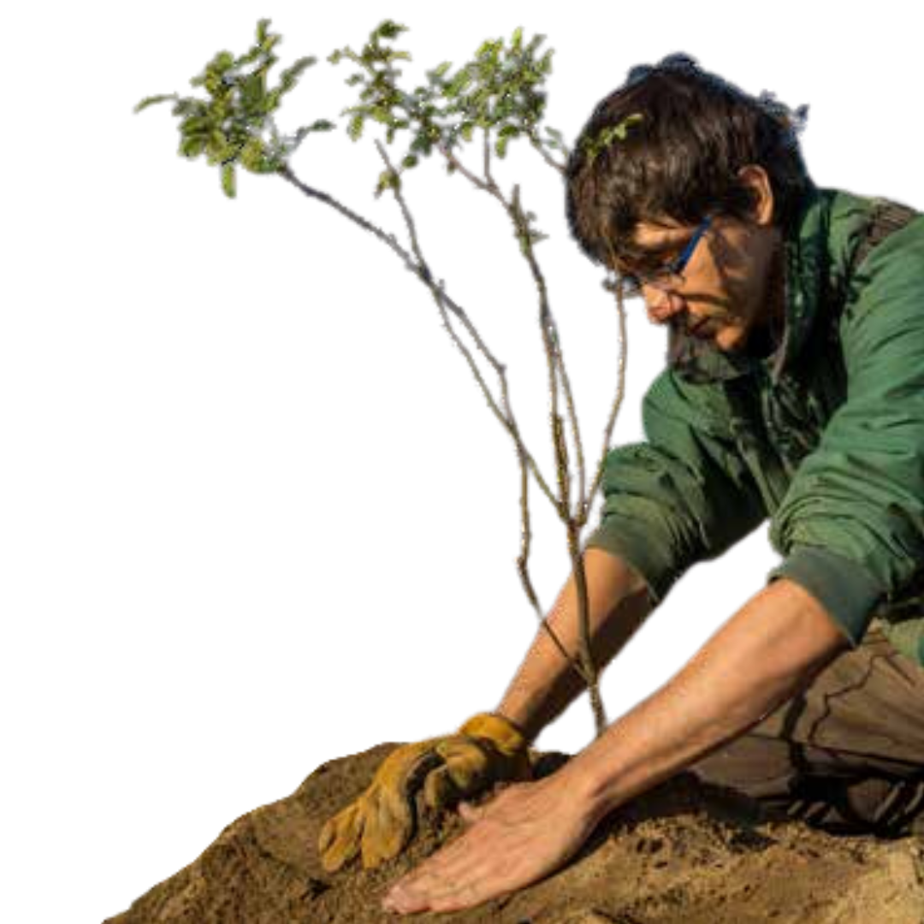
Multi-Benefit Floodplain Restoration
Biodiversity
Flood Safety
Climate Resilience
Vibrant Communities
Water Conservation & Replenishment
Native Seed Supply
Notes:
Bringing back disappearing wildlife – our efforts support the recovery of over 55 imperiled species
Boosting flood safety – for communities in flood-prone regions by restoring floodplains that slow down and soak up water
Growing California's climate resilience – by planting nearly 4 million trees that have captured 1 million tons of greenhouse gases since our founding in 1998
Conserving fresh water – the riverways we restore conserve 1 billion gallons of water each year, boosting supplies for wildlife, farming, and households
Creating healthy communities – by expanding access to open space for recreation
Building strong economies – we've channeled over $150 million of restoration-related dollars into the communities we work in statewide

Slide 4
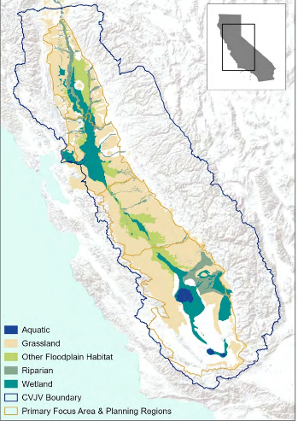
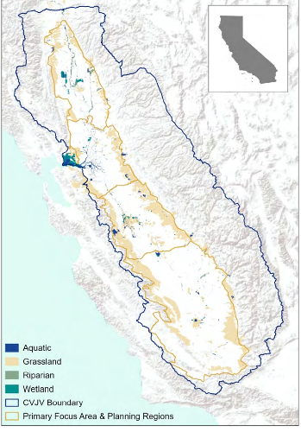
Central Valley Historical Ecology
Circa 1980
Circa 2020
Notes:
Bringing back disappearing wildlife – our efforts support the recovery of over 55 imperiled species
Boosting flood safety – for communities in flood-prone regions by restoring floodplains that slow down and soak up water
Growing California's climate resilience – by planting nearly 4 million trees that have captured 1 million tons of greenhouse gases since our founding in 1998
Conserving fresh water – the riverways we restore conserve 1 billion gallons of water each year, boosting supplies for wildlife, farming, and households
Creating healthy communities – by expanding access to open space for recreation
Building strong economies – we've channeled over $150 million of restoration-related dollars into the communities we work in statewide

Slide 5
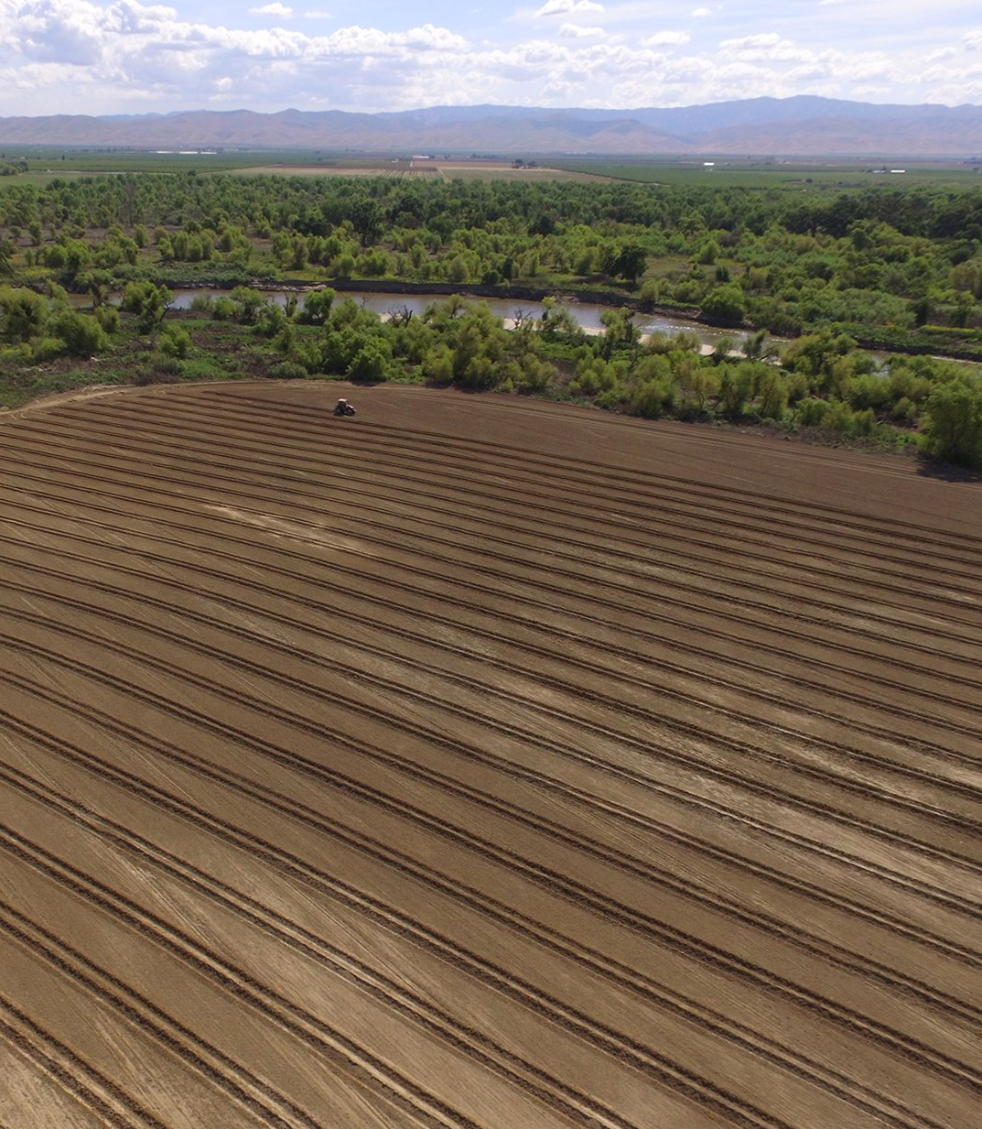
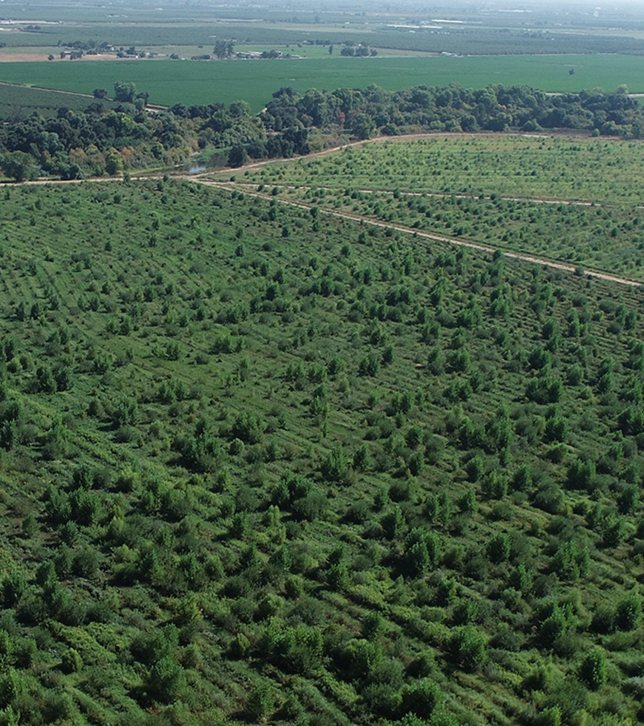
Before
2018
After
2022
Notes:
Dos Rios Ranch Preserve, which was restored over a decade between 2012-2022. Before is Field 12 in May 2018, and after is from 2022.

Slide 6
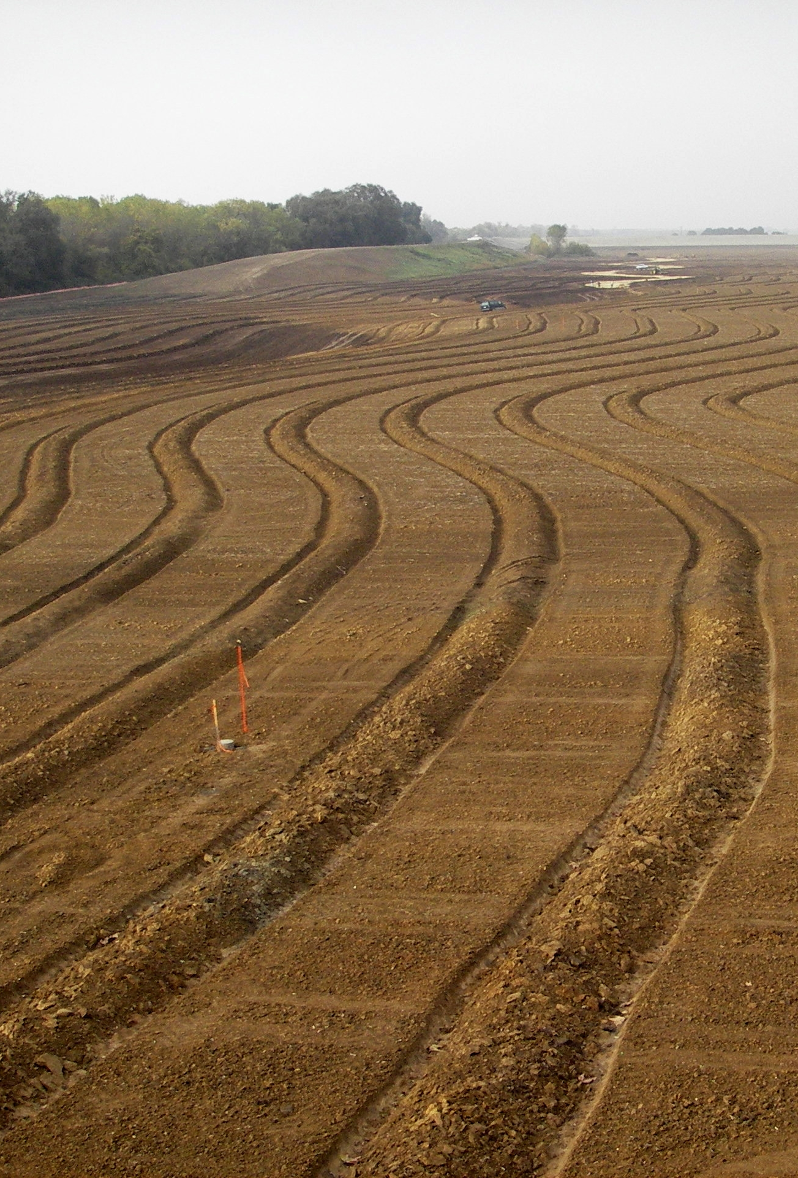
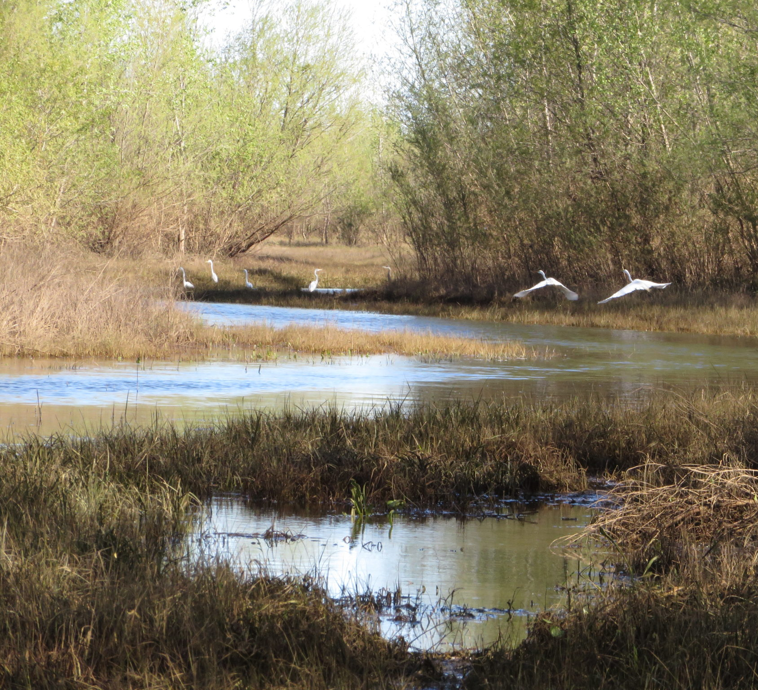
Before 2008
After 2012
Notes:
Bear River Floodplain Restoration – dates? – near Yuba City

Slide 7
Notes:
For over 25 years, River Partners has led more than 300 major restoration projects in over 20 watersheds across nearly 20,000 acres of critical river landscapes throughout the
state.

Slide 8
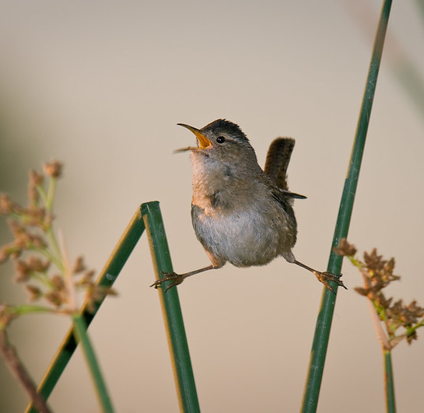
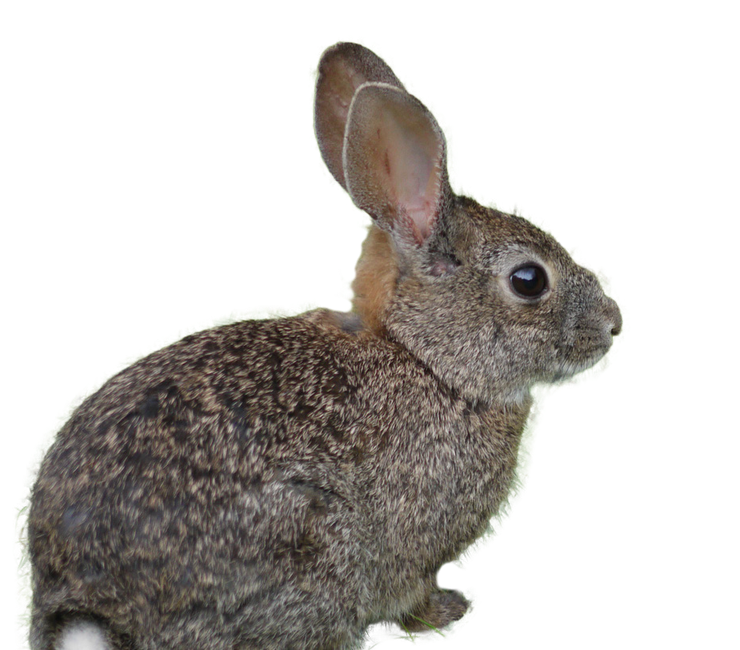
Results that matter
Over the last 26 years, we’ve doubled California’s footprint of native river habitat, bringing life back to nearly 20,000 acres and hundreds of communities statewide
We’re the only group driving large-scale floodplain restoration in the Central Valley—and have the largest river-restoration footprint in the West
Our work supports bold state-led initiatives such as 30X30,
CA Climate Commitment, CA
Biodiversity Initiative, CA Water
Resilience Portfolio, Outdoors
for All, and many others
Notes:
Our work matters for wildlife, natural resources, and communities.

Slide 9
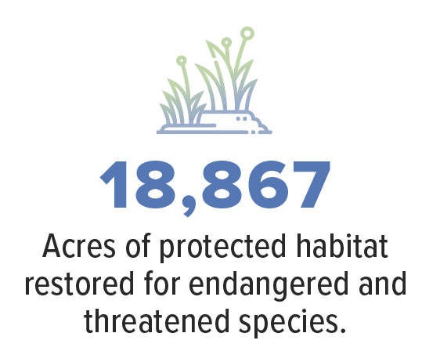
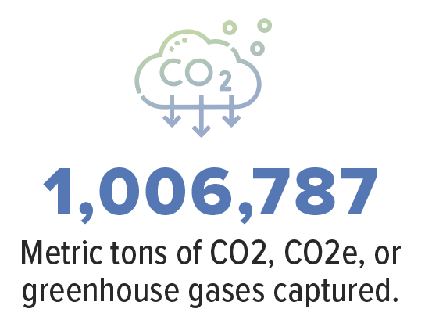
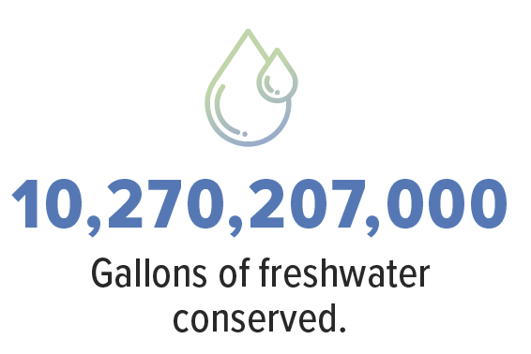
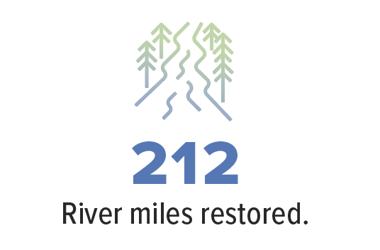
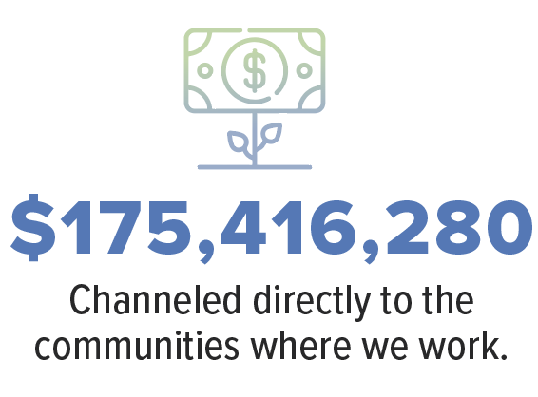
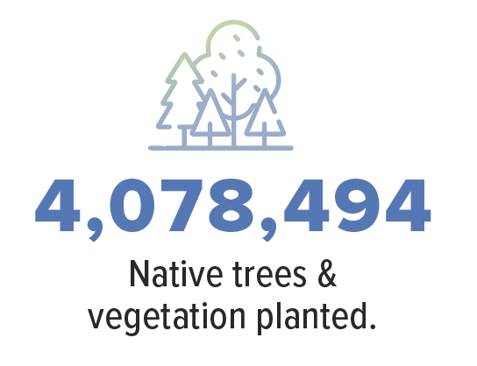
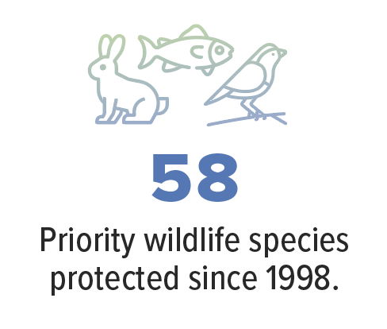

Slide 10
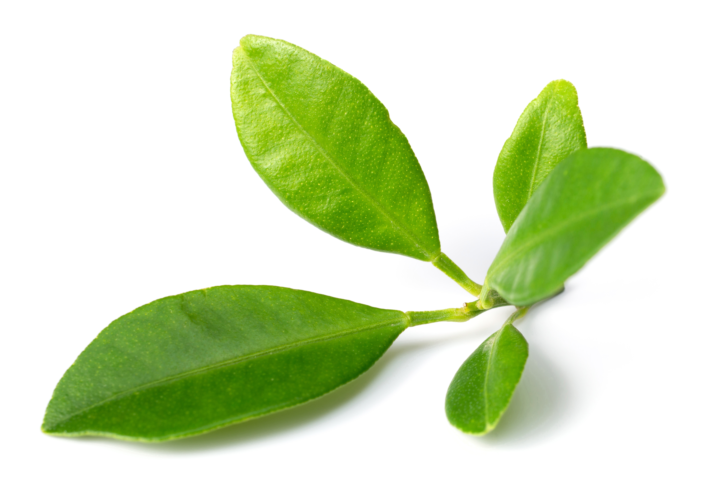
Recognition
Notes:
Optional slide to talk about our recognition in news media

Slide 11
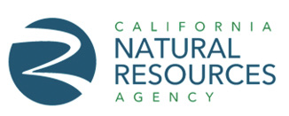
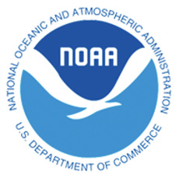
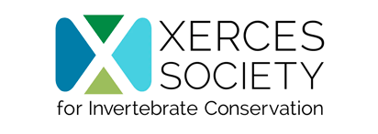
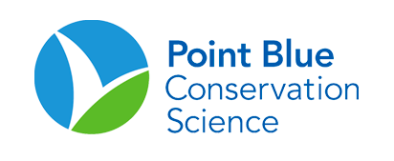
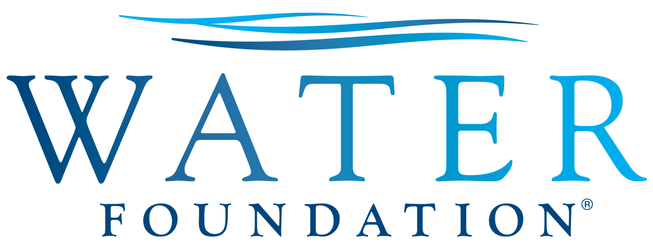
Partners
Public Agencies
Nonprofit Organizations
California Tribes
Foundations
Academic & Scientific Orgs
Corporations
Notes:
Optional Slides, change out headers as needed to highlight important project partners

Slide 12
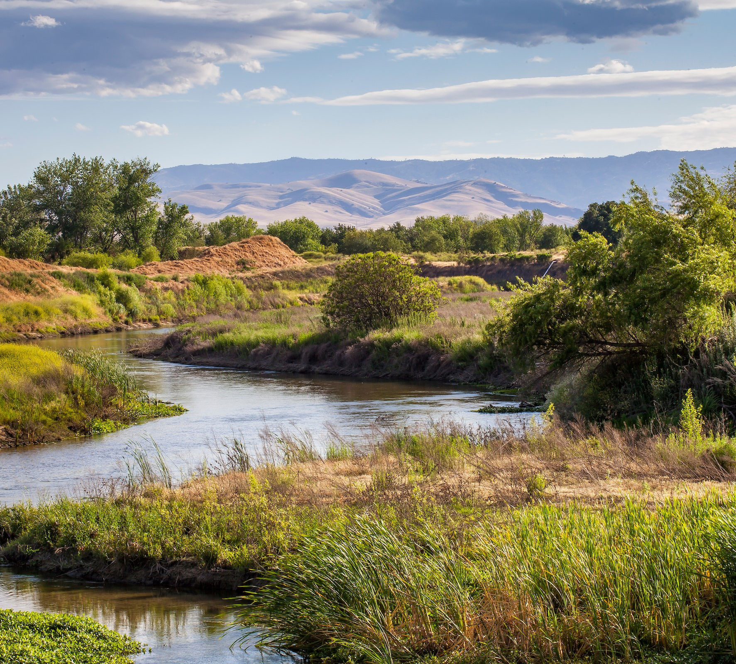
Heading
Body text
Notes:
Template for slides

Slide 13
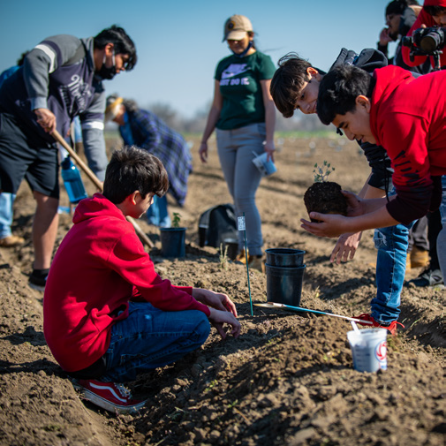
Heading
Body text
Notes:
Template for slides

Slide 14
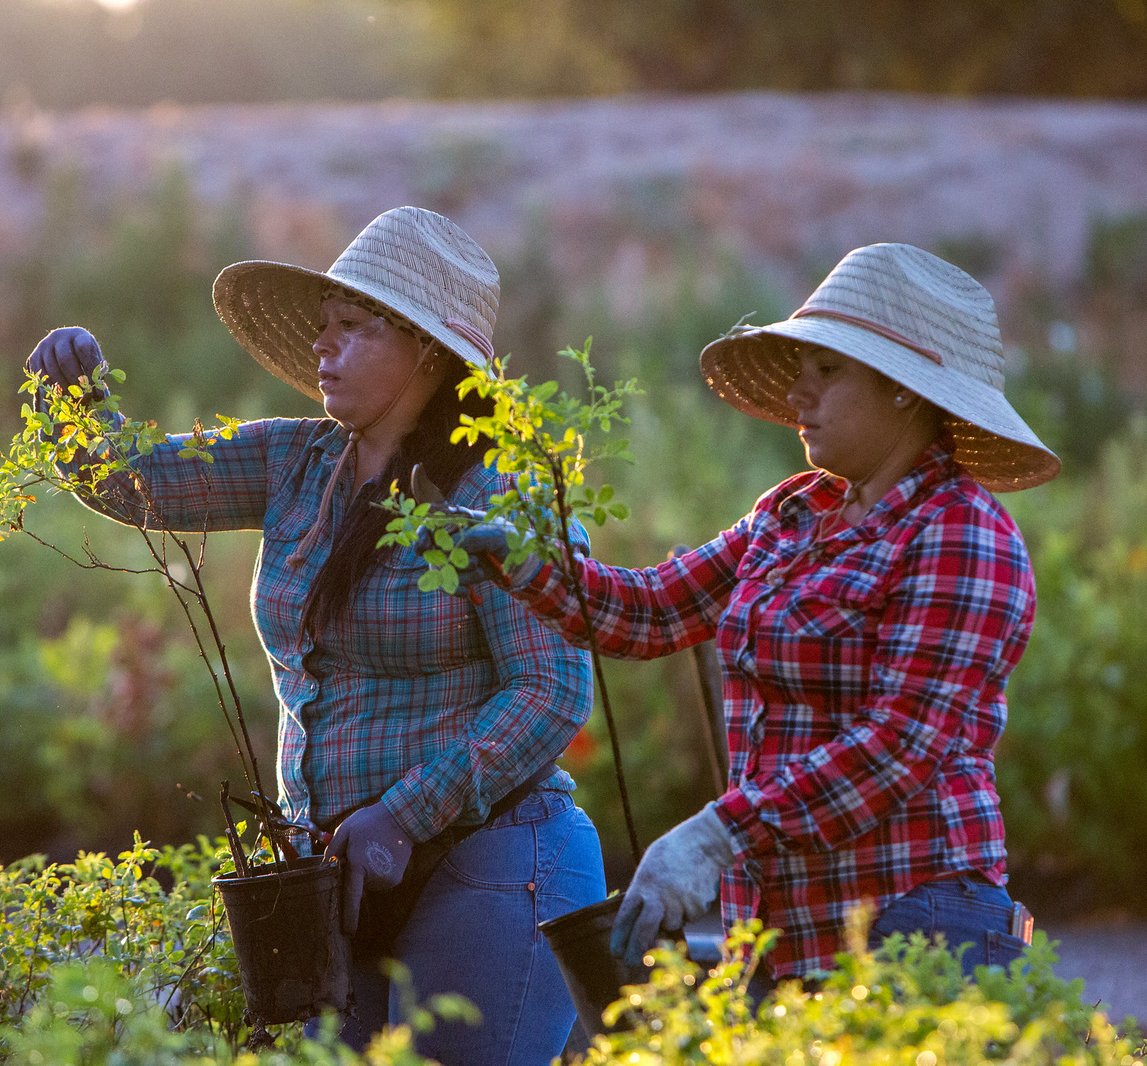
Doubling our impact
We’re doubling the number of restored riverside acres by 2030
But we can’t do it alone
Ensuring a thriving future requires bold public and private investments that are needed now, not years from now
Join us - donate at riverpartners.org
Notes:
The actions we take during this decade will decide California's future. With their exponential benefits for wildlife, natural resources, and communities, healthy rivers are critical for a flourishing Golden State for generations to come. Join us and make a donation today.

Slide 15
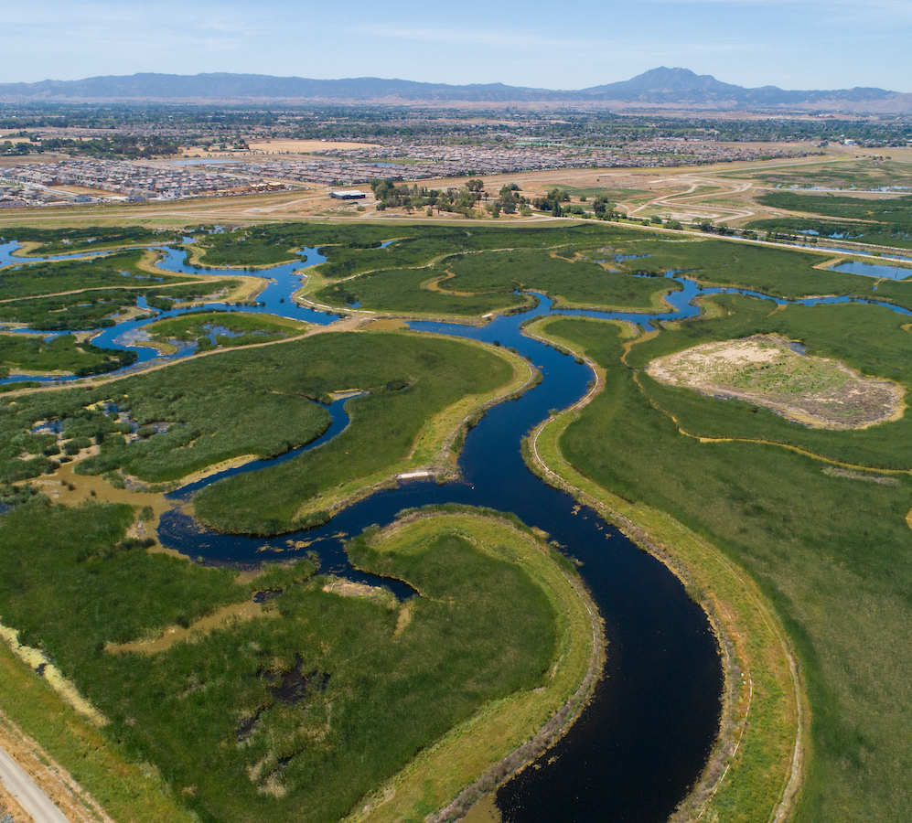
Connect with us

